Slide 1

Simple RNN for Forecasting

Slide 2
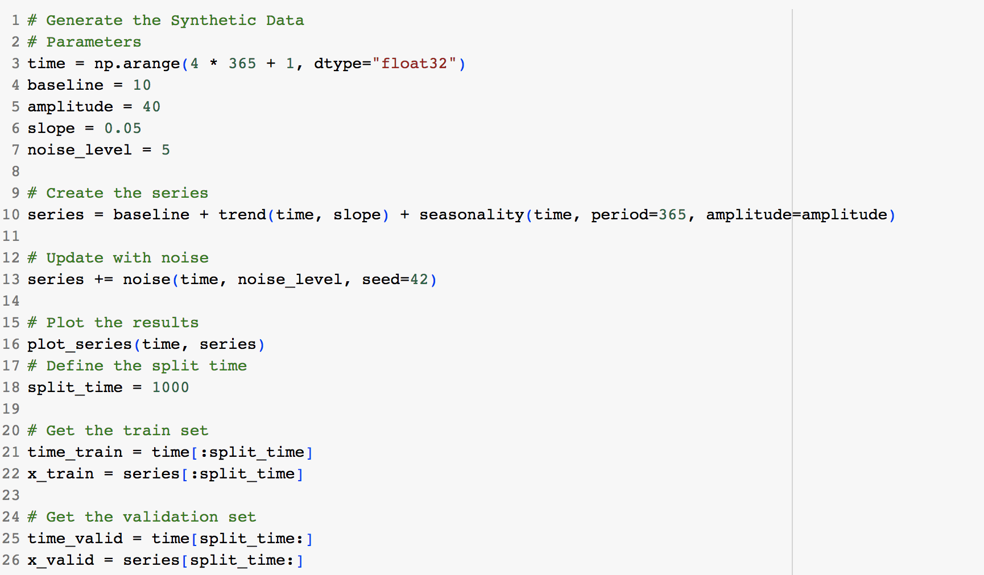
Objectives
Lab 4.3: Simple RNN for forecasting.ipynb.
Dataset:
  the Synthetic Data

Slide 3
Q & A

